Slide 1
DR.SNSRCAS, CBE
SUBJECT: ADVANCED JAVA PROGRAMMING
COURSE CODE:16UCA502
TITLE: JSP - Lifecycle
YEAR: V SEMESTER 2022-2023 (ODD)

Slide 2
JSP - Lifecycle
Paths Followed By JSP
The following are the paths followed by a JSP
1.Compilation
2.Initialization
3.Execution
4.Cleanup

Slide 3
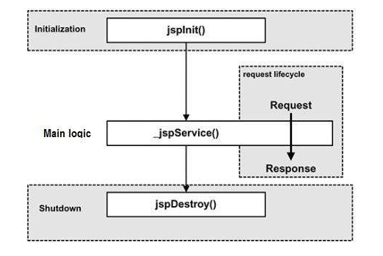
JSP - Lifecycle
The four major phases of a JSP life cycle are very similar to the Servlet Life Cycle. The four phases have been described below −

Slide 4
JSP - Lifecycle
JSP Compilation
When a browser asks for a JSP, the JSP engine first checks to see whether it needs to compile the page. If the page has never been compiled, or if the JSP has been modified since it was last compiled, the JSP engine compiles the page.

Slide 5
JSP - Lifecycle
JSP Compilation
The compilation process involves three steps
Parsing the JSP.
Turning the JSP into a servlet.
Compiling the servlet.

Slide 6
JSP - Lifecycle
JSP Initialization
When a container loads a JSP it invokes the jspInit() method before servicing any requests. If you need to perform JSP-specific initialization, override the jspInit() method.
public void jspInit(){ // Initialization code... }

Slide 7
JSP - Lifecycle
JSP Execution
This phase of the JSP life cycle represents all interactions with requests until the JSP is destroyed.
Whenever a browser requests a JSP and the page has been loaded and initialized, the JSP engine invokes the _jspService() method in the JSP.

Slide 8
JSP - Lifecycle
JSP Execution
The _jspService() method takes an HttpServletRequest and an HttpServletResponse as its parameters as follows −
void _jspService(HttpServletRequest request, HttpServletResponse response)
{ // Service handling code... }

Slide 9
JSP - Lifecycle
JSP Execution
The _jspService() method of a JSP is invoked on request basis. This is responsible for generating the response for that request and this method is also responsible for generating responses to all seven of the HTTP methods, i.e, GET, POST, DELETE, etc.

Slide 10
JSP - Lifecycle
JSP Cleanup
The destruction phase of the JSP life cycle represents when a JSP is being removed from use by a container.
The jspDestroy() method is the JSP equivalent of the destroy method for servlets. Override jspDestroy when you need to perform any cleanup, such as releasing database connections or closing open files.

Slide 11
JSP - Lifecycle
JSP Cleanup
The jspDestroy() method has the following form −
public void jspDestroy()
{ // Your cleanup code goes here. }

Slide 12
THANK YOU

